Slide 1
Self-Service Appointment Scheduling Dashboard
Implementing the Volume Cohort lens

Slide 2
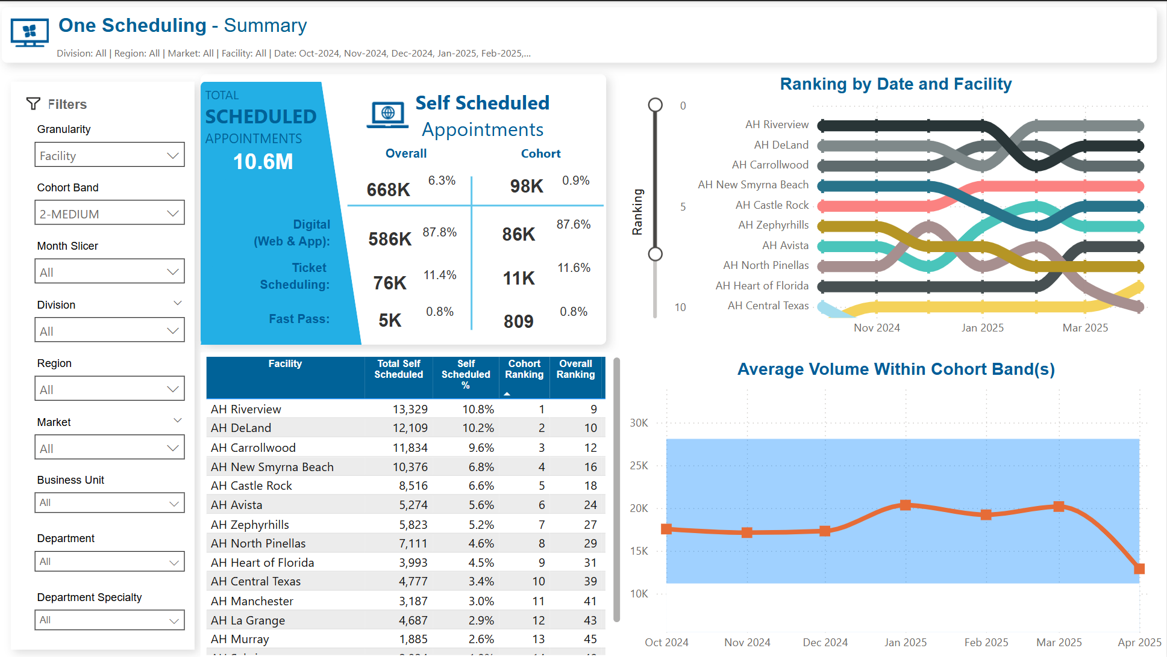
Full Cohort Implementation

Slide 3
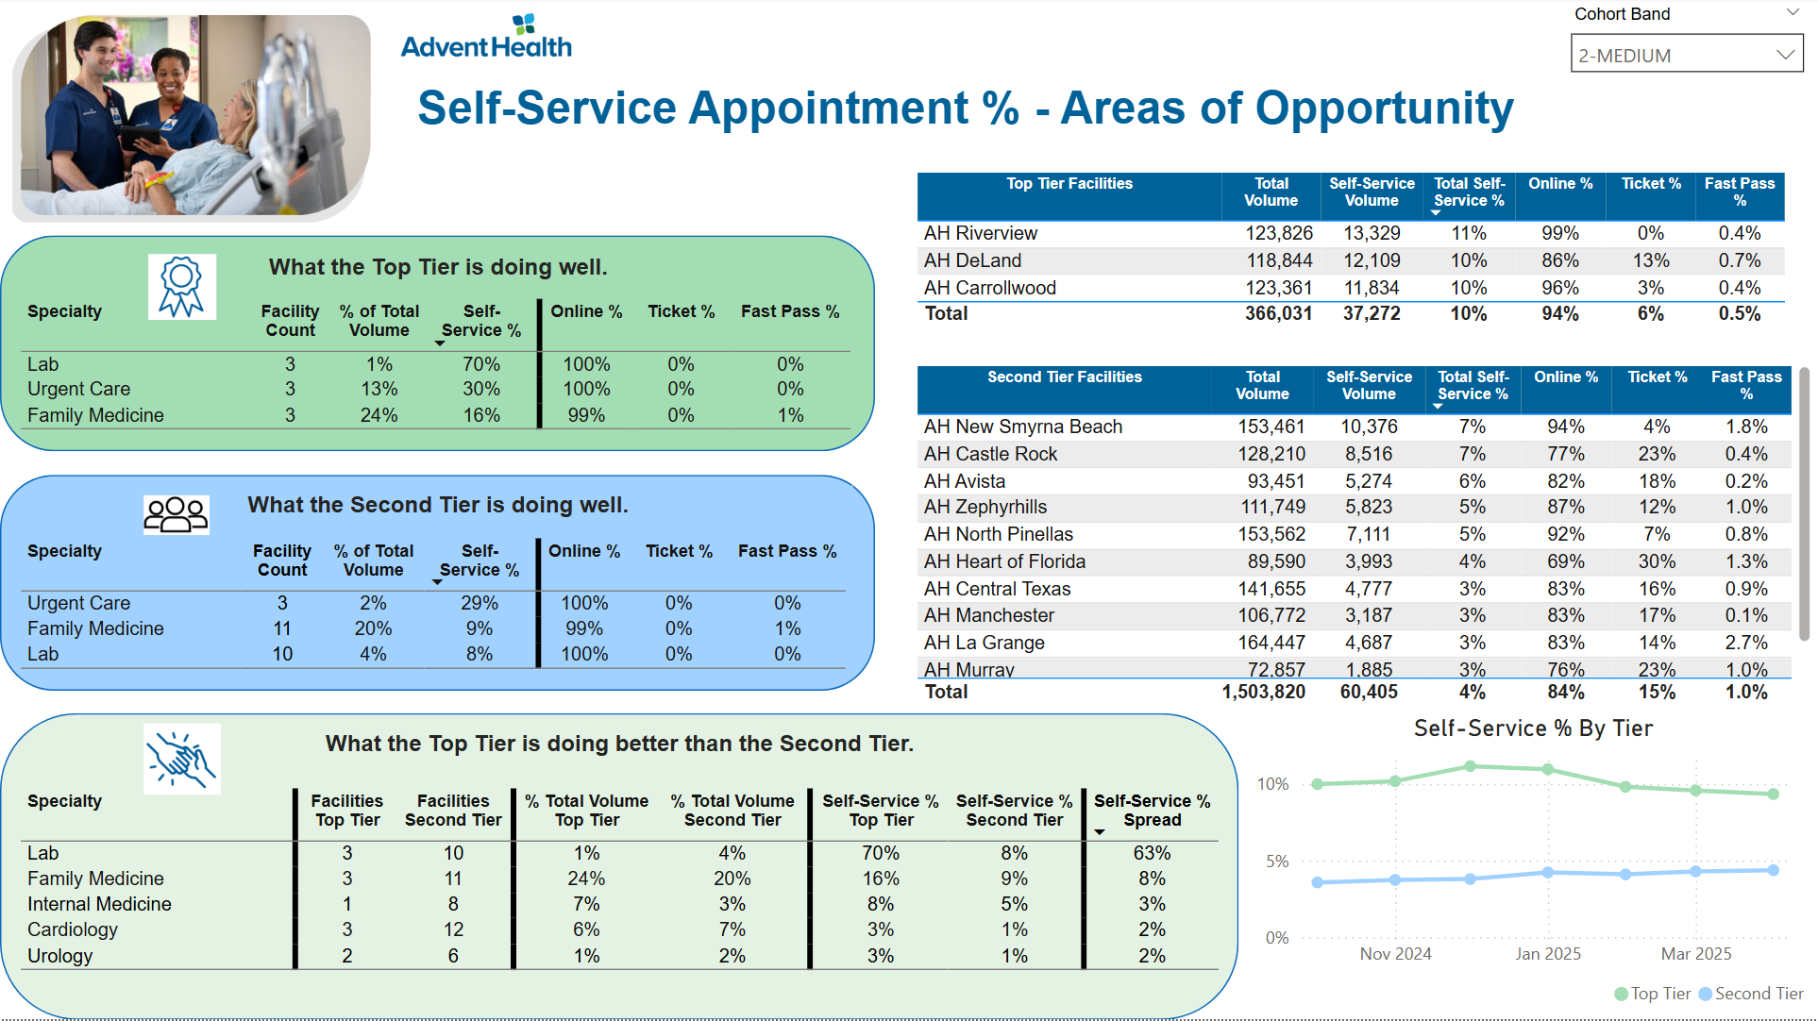
Areas of Opportunity Summary

